Slide 1

Logistic Regression
Classifying Data Scientist’s salary range
Prepared by: Eraj Ahmed
Student ID: 999177037
Course: Introduction to Data Science & Analytics
Course Code: MIE 1624

Slide 2
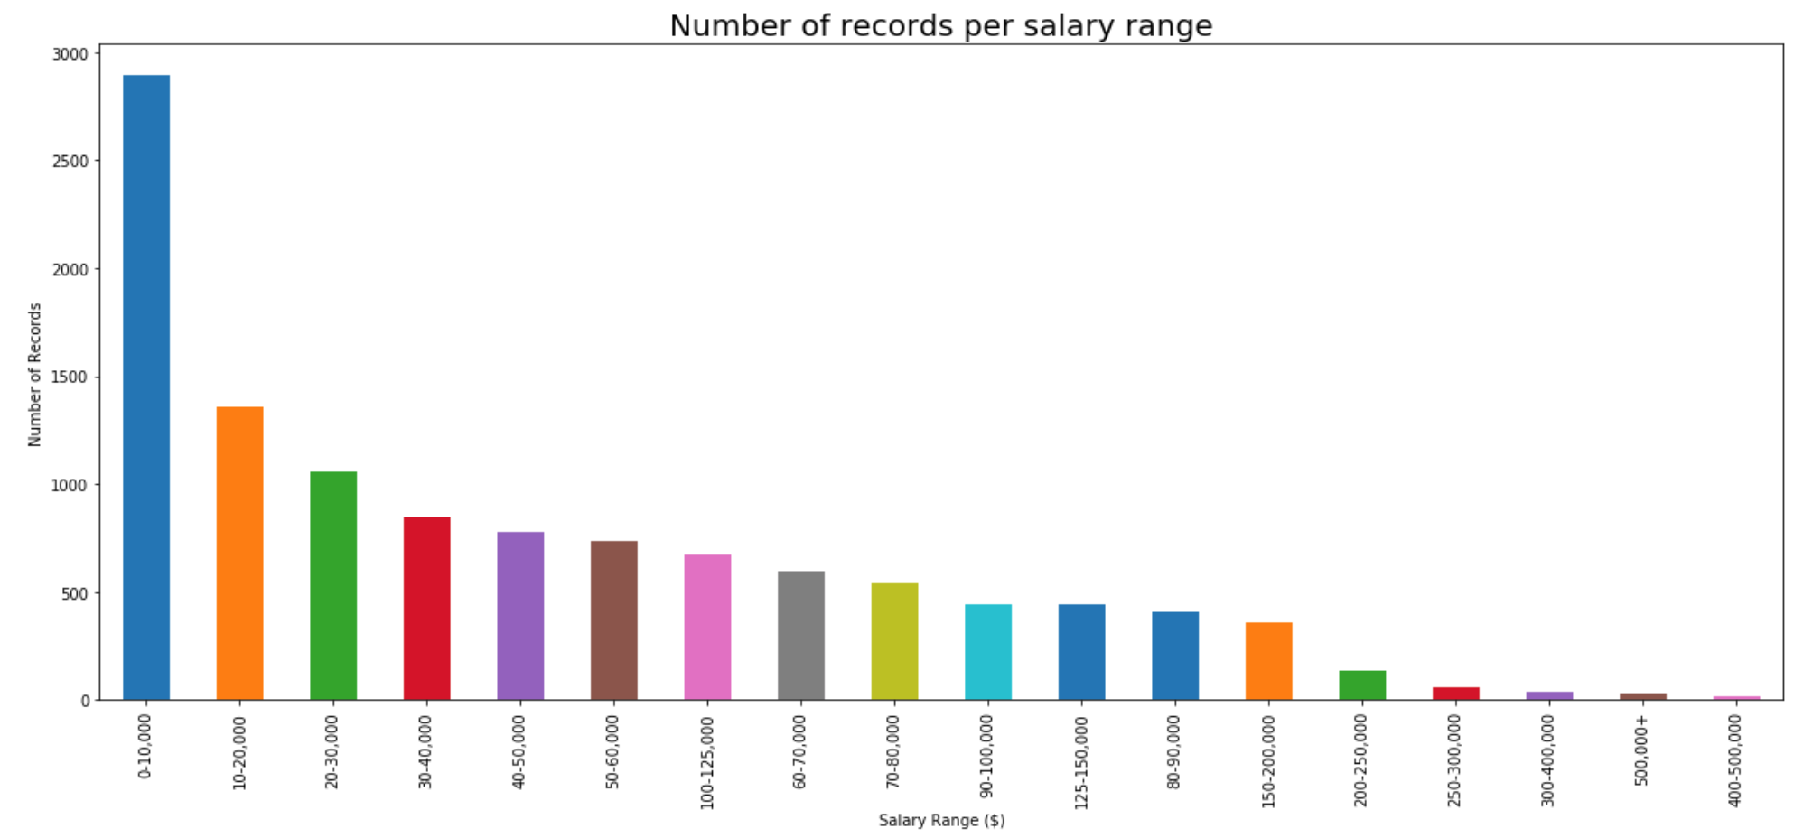
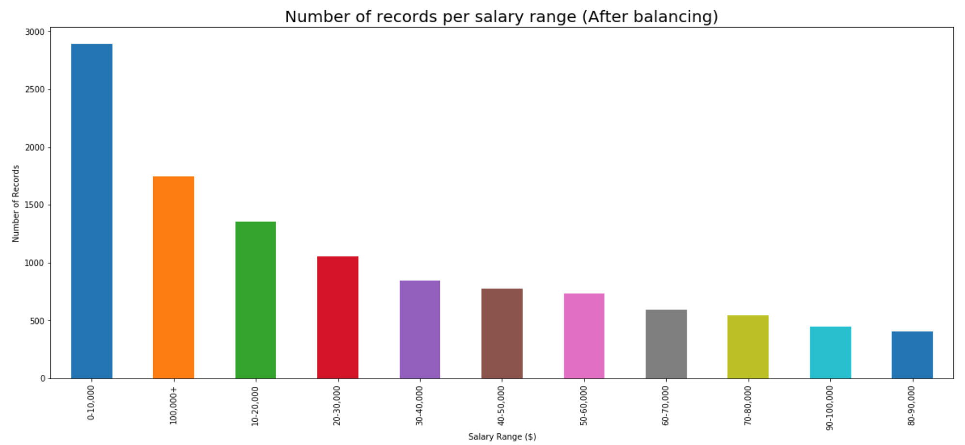
EXPLORATORY ANALYSIS
The dataset is an imbalanced as can be seen from the initial bar chart. There are too few samples when the salary range crosses $150,000. In order to balance the dataset, all the salary ranges after $100,000 and up are put in one bucket as target variable. The resulting distribution can be seen below as well.
Sample distribution before balancing
Sample distribution after balancing

Slide 3
FEATURE SELECTION
In the feature engineering process, three techniques are applied.
Dropping features with high collinearity with each other
Selecting important features using chi square test as the target is categorical and the features are all numerical
Using PCA to reduce dimensionality
Data Cleanup
Correlation Matrix
Chi Square Test
PCA
694
Features
648
Features
10
Features
5
Features
Original number of features after data cleaning (using both label encoding and one hot encoding)
Dropping features with collinearity higher than 70 percent
Selecting top 10 features using chi square test (categorical target and numerical features)
Reducing the number of features from 10 to 5 using PCA

Slide 4
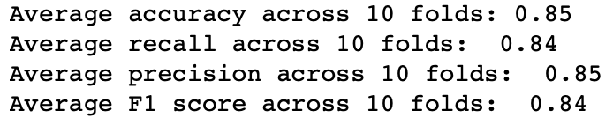
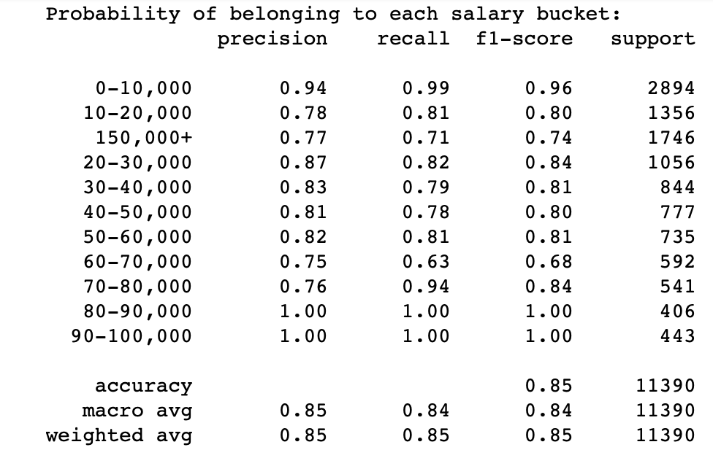
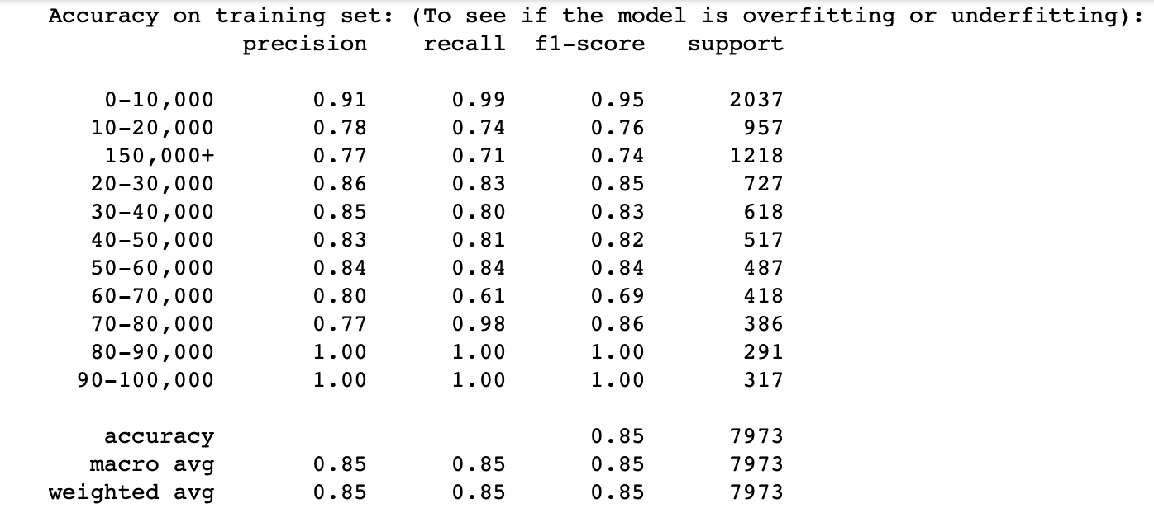
MODEL RESULTS
The following hyper-parameters were tuned using grid search:
Using the tuned hyperparameters, my model and results are as follows:
Selected metrics for each target class (testing data): Selected metrics for each target class (training data):

Slide 5
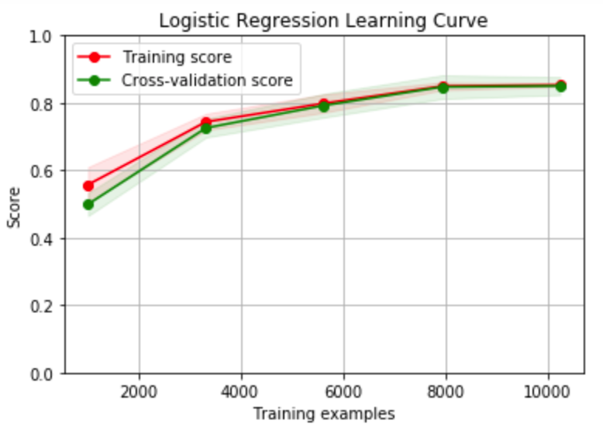
MODEL DISCUSSION
As it can be seen from the slide before, the scores on the training set are close with the scores on the testing set. This is further validated by plotting a learning curve which shows that our model is neither underfitting or overfitting and is converging to an acceptable accuracy at low model complexity (fewer samples). Therefore, it can be safely concluded that this a good model and the selected metrics (precision and recall) are satisfied with the result.

